Slide 1


.NET Foundation Update
Claire Novotny – Executive Director
Layla Porter – Board of Directors

Slide 2

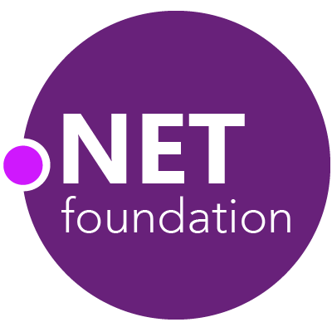
Steeltoe
.NET Core
Docker.DotNet
MSBuild
DotNetNuke
Coverlet
ASP.NET Core
SourceLink
NuGet Trends
FluentValidation
nUnit
MVVM Light Toolkit
IronPython
Mailkit
WorldWide Telescope
Nancy
Open XML SDK
.NET SDK for Hadoop
MvvmCross
MEF
Mimekit
xUnit
Esquio
NuGet
Polly
ImageSharp
iOS
macOS
Entity Framework
.NET ECOSYSTEM
WCF
ILMerge
Xamarin.Mobile
ASP.NET SignalR
ReactiveUI
Open Live Writer
Mono
Xamarin.Auth
Xamarin SDK
Orchard CMS
Nerdbank.GitVersioning
ProtoBuild
IdentityServer
Verify
.NET Compiler Platform ("Roslyn")
Prism
Kerberos.NET
Cake
Orleans
Kudu
Cecil
LLILC
Umbraco
System.Drawing
MahApps.Metro
Notes:
The .NET Foundation is our center of gravity for open development and collaboration around the .NET ecosystem. The .NET Foundation has over 100 projects and hundreds of repos under its stewardship. Open Source Software foundations provide protection, support, services and best practices for helping each project be successful and to grow the ecosystem of people and software. Learn more www.dotnetfoundation.org

Slide 3
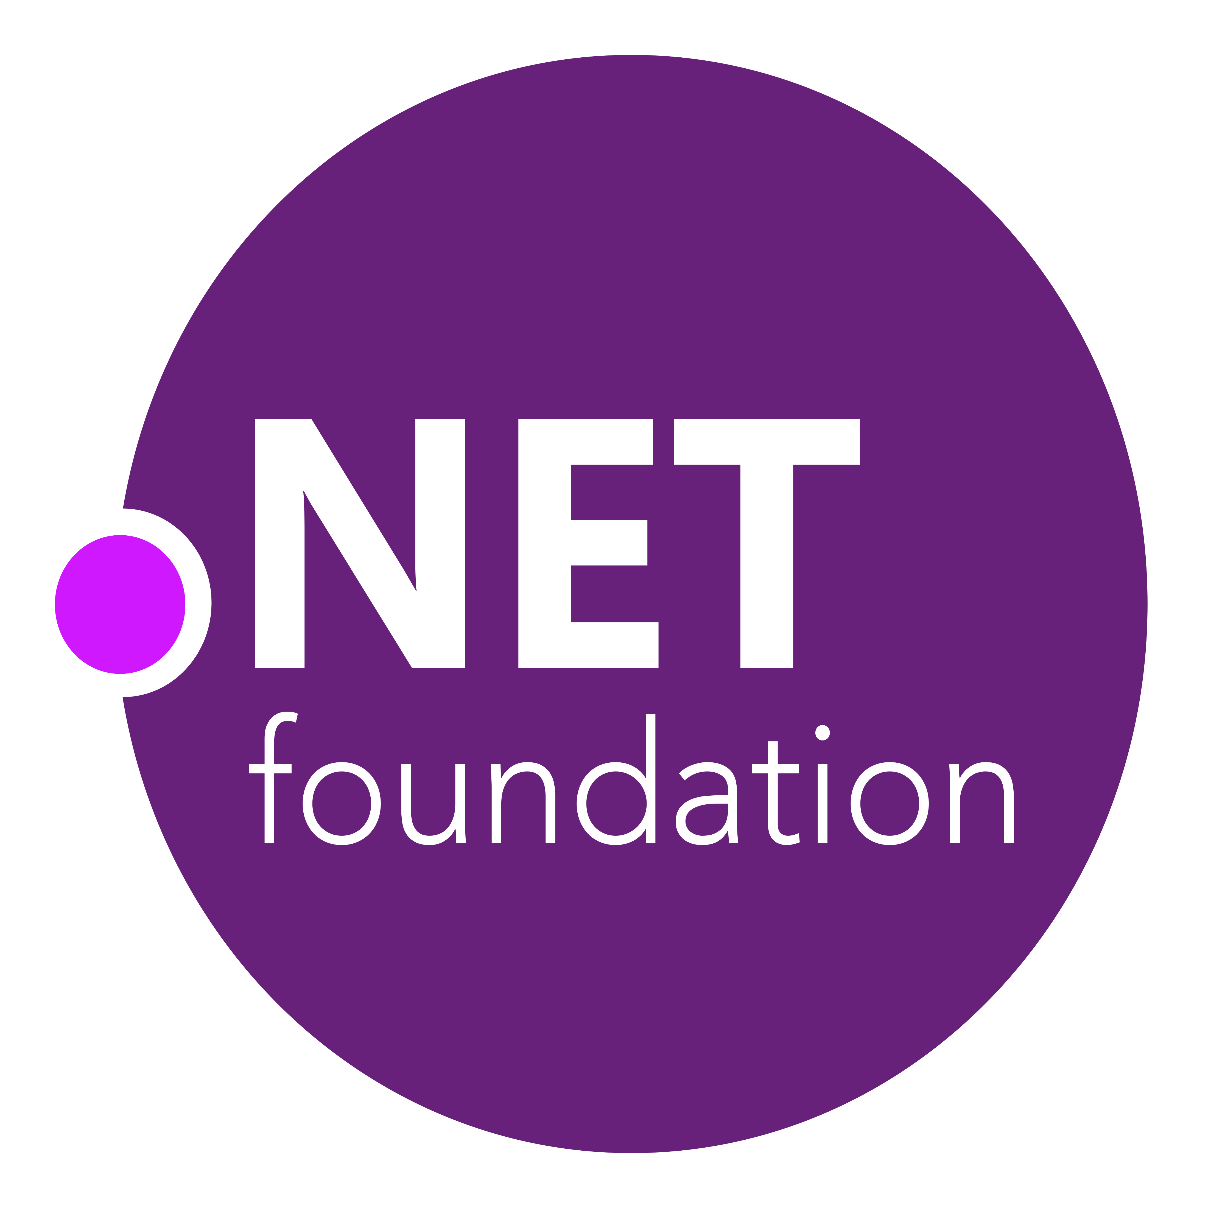
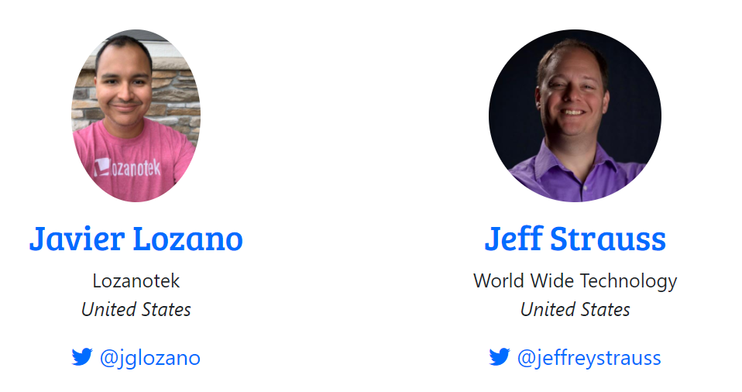
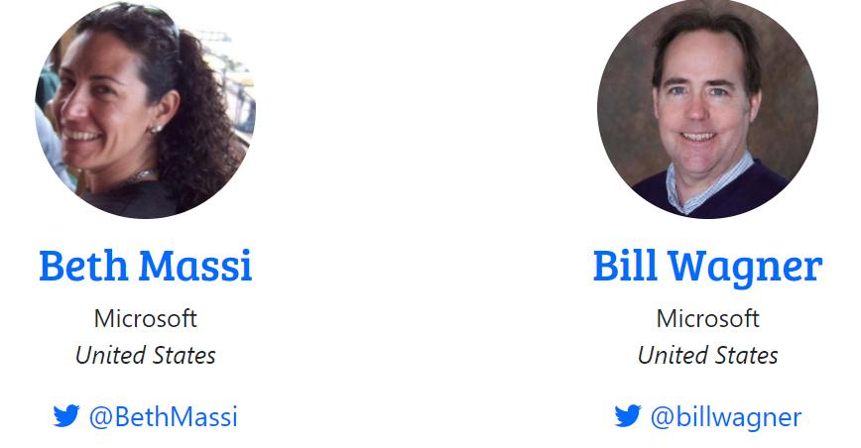
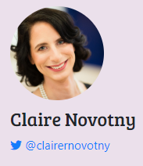
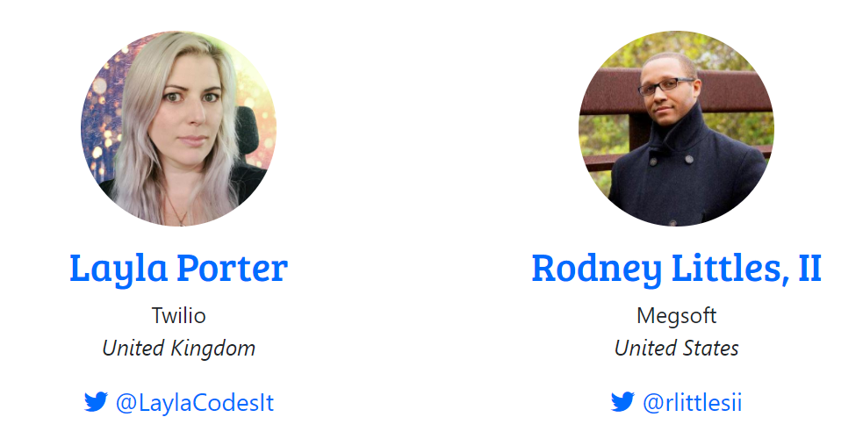
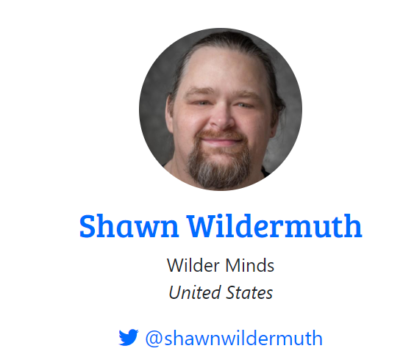
Leadership Team
Executive Director
dotnetfoundation.org/community/committees
Notes:
The board comes from the passionate .NET community. Here is the elected board of the .NET Foundation, elected in August 2020, except for Beth Massi who is appointed by Microsoft. As you can see, we have a pretty good representation of women on the board. We had over 40 candidates run for the board from all sorts of backgrounds so it was good to see the diversity in our passionate community.
<CLICK>
Claire Novotny, originally elected and from a SI called Insight, is now our new Executive Director, replacing the awesome Jon Galloway. We’re very excited to have Claire working for the Board.

Slide 4
Fostering a vibrant .NET ecosystem
Protection
Legal / IP
CLAs
Copyright
Trademarks
Practices
Governance
Feedback
Mentorship
Coordination
Visibility
Marketing
Communications
Events
Support
Hosting
Code signing
DevOps
Openness. Community. Innovation.
github.com/dotnet-foundation
dotnetfoundation.org
Notes:
.NET is more than just the platform, it’s also the community and ecosystem of open source projects. The .NET Foundation is here to foster that ecosystem and make sure it not only survives but flourishes. The foundation performs many functions from Legal and project services to mentoring and running events.

Slide 5
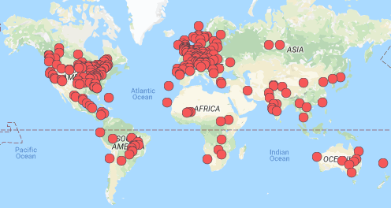
.NET Foundation Sponsored Meetups
Members
317K+
Groups
371+
Countries
67+
meetup.com/pro/dotnet
Notes:
We’re a huge community and the .NET Foundation is key to help foster it. We have over 5 .NET million developers worldwide and .NET has grown its developer base by 1 million over the last year. There are meetups all over the world that speak on all sorts of .NET topics and application development and we’ve also seen a lot of growth in membership. Here are the ones on meetup.com.

Slide 6
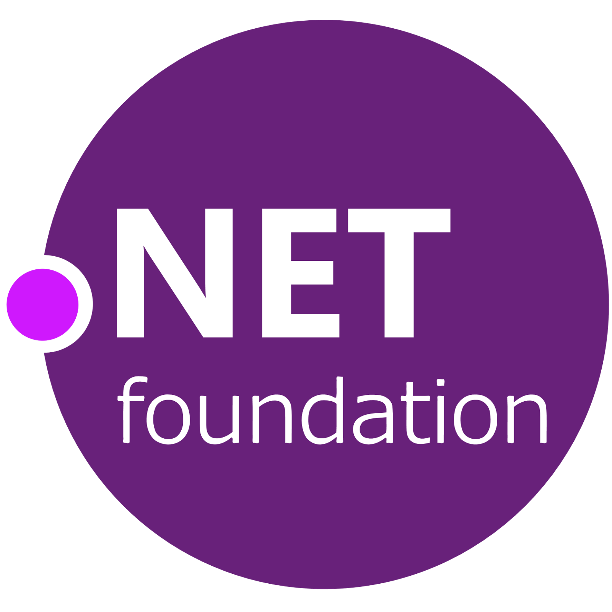
OSS Partners for .NET 5 – Thank you!
OPEN SOURCE
Ant Design Blazor
ImageSharp
And many more…
bUnit
Live Reload Middleware for ASP.NET Core
Blazm
MatBlazor
Blazor Extensions
NuGet Package Explorer
Blazored
Oqtane
Blazorise
Reactive Extensions
BlazorStrap
Swashbuckle
Cake
Uno Platform
IdentityServer
Notes:
We also want to call out specific open source projects that had a big impact making the .NET 5 release awesome, as well as those projects that are built on .NET 5 today.
Of course, there are many more .NET open source projects under the .NET Foundation that make the .NET ecosystem a great place to be.
THANK YOU!!
<CLICK>

Slide 7


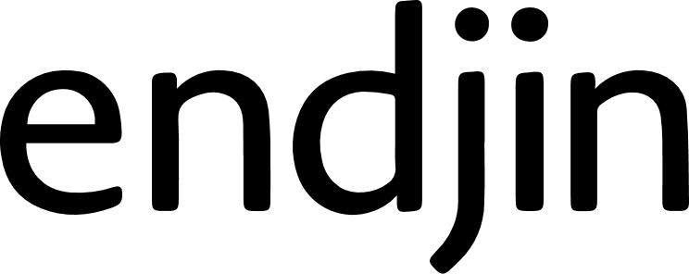
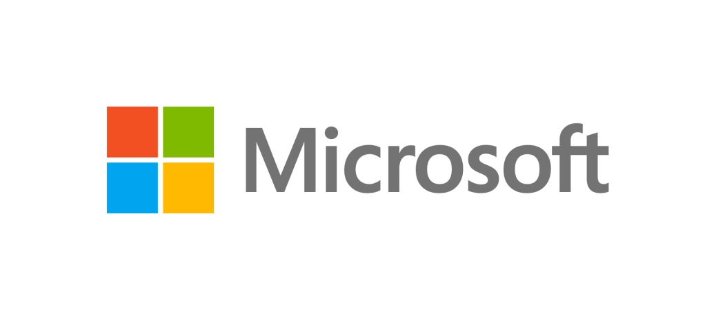
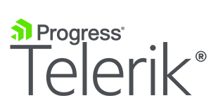

CORPORATE SPONSORS
These companies are helping grow the .NET ecosystem
Notes:
So who’s behind the .NET Foundation? It’s not just individuals, it’s large companies that are invested in the future of .NET. .NET is bigger than Microsoft. The corporate sponsors of the .NET Foundation are helping guide .NET into the future together with industry partners.

Slide 8
.NET Foundation News
Corporate Membership Program
Documentation writers
Human localization
UX/design/logo/website
Other professional services as needed
Membership is now at 886 members
77% growth YTD
111 active projects, more joining regularly
Notes:
I think the key point is that we're going to introduce corp member very shortly to enable us to scale
so we can hire people to do x, y, z for member projects

Slide 9

.NET Foundation Survey
We want to hear from you!
Your important feedback will help us understand our community needs better and prioritize the work that we do
Results will be made public
Go to bit.ly/dnf-survey to participate, or click the button on our home page
www.dotnetfoundation.org

Slide 10
Become a member
Help make decisions, partake in discussions
Join committees and prioritize initiatives
Submit proposals to drive activities and secure funds
Help (or drive) activities
Keep up with what’s new
Vote on (and run for) Board of Directors
dotnetfoundation.org/member
Notes:
As a member, you can partake in ongoing discussions, vote on the board of directors, directly help with one of the many action groups and more. By providing a forum, influential contacts, a passionate community, consolidated resources, funds, we provide a unified place where you can influence the .NET ecosystem in a variety of ways. We solve problems you care about, and we care about your opinion.

Slide 11

Are you ready to learn and have fun!?

Slide 12

Conference-at-a-glance
Day 1 - November 10
8:00 - 9:00 Keynote
9:00 - 17:00 Sessions from the .NET Team at Microsoft.
17:00 - 18:00 Virtual Attendee Party! Engage with our sponsors and win prizes.
Day 2 - November 11
9:00 - 17:00 Sessions from various teams at Microsoft.
17:00 - 23:59 Community Sessions in local time zones around the world
Day 3 - November 12
0:00 - 17:00 Community Sessions in local time zones around the world
All times listed are Pacific Time
24hr broadcast
www.dotnetconf.net/agenda

Slide 13
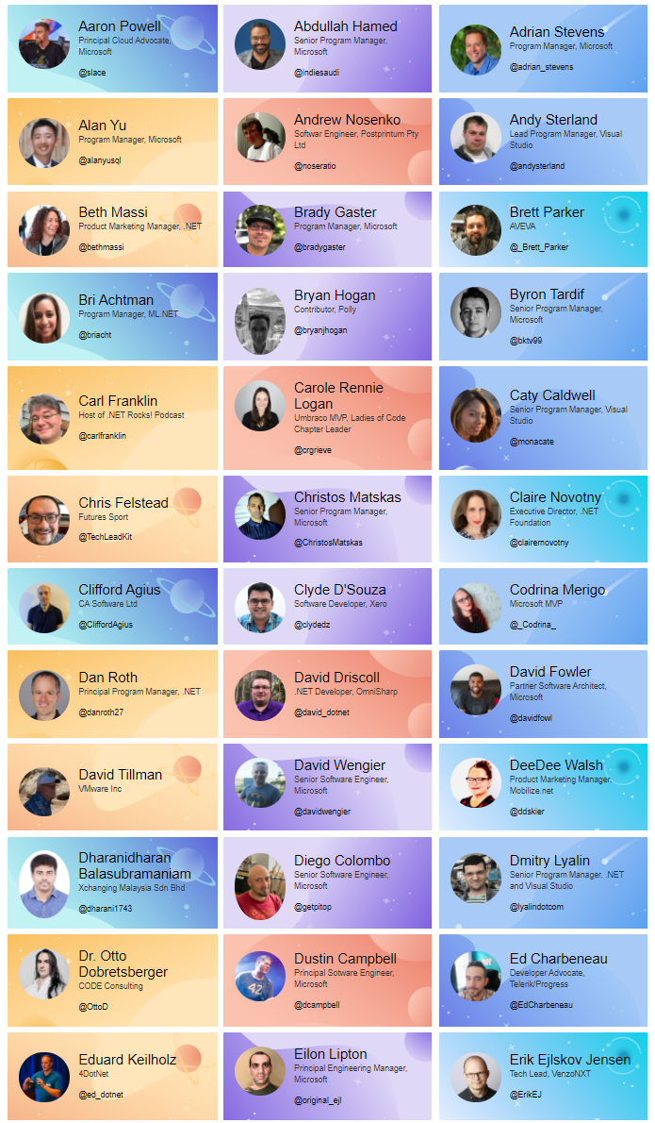
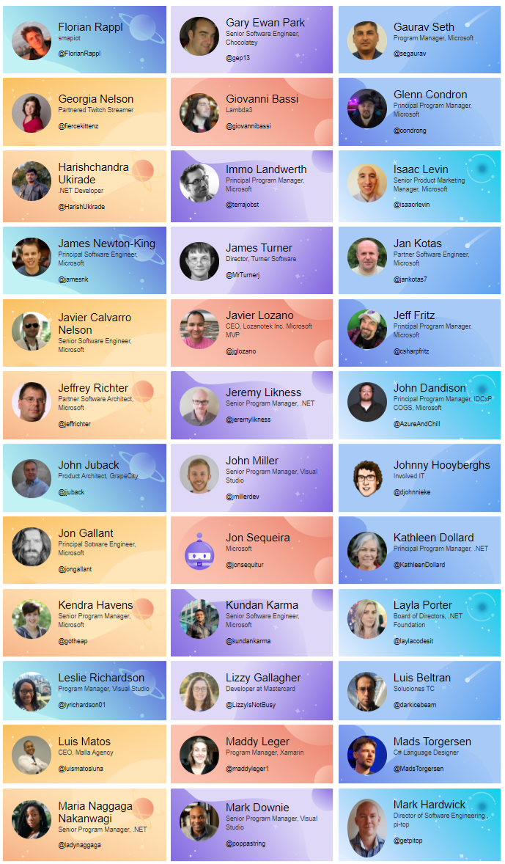
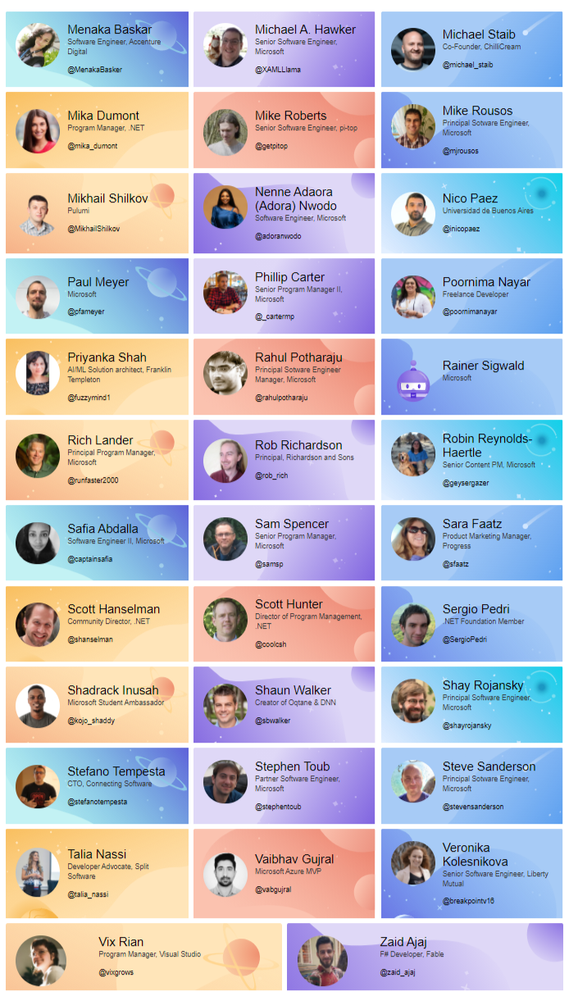
Thank you to our amazing speakers!
www.dotnetconf.net/speakers

Slide 14

Ask questions on Twitter: #dotNETConf
If your question ends up being asked on the live broadcast, we’ll DM you a gift!

Slide 15
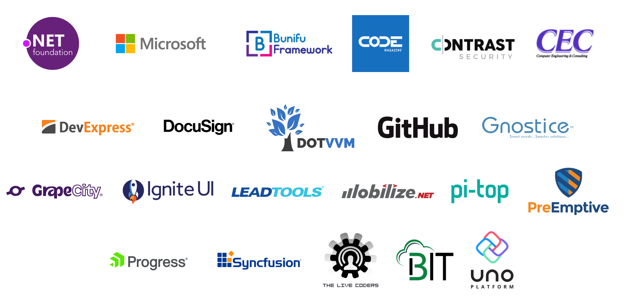
Sponsors, Swag, Fun & Games
Virtual Attendee Party
Trivia Questions
Technical Treasure Hunt
Swag Bags
Digital Swag
Over $200K in prizes

Slide 16
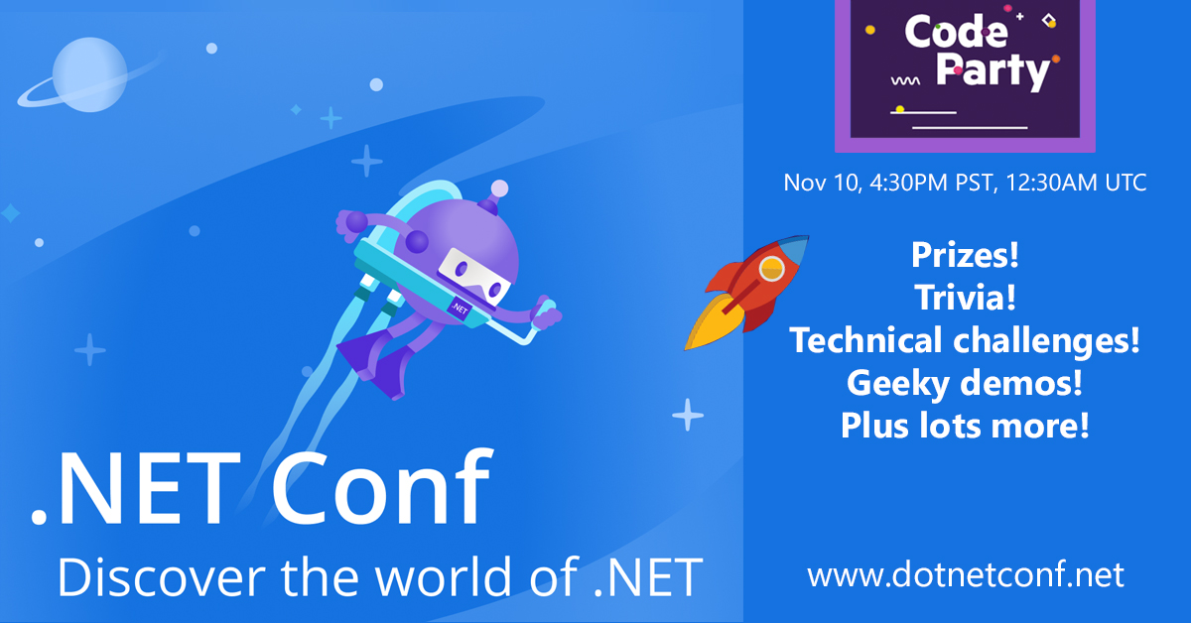
CodeParty – Attendee Party
Live party with games, prizes and interviews
Starts @4:30PM PST, after Scott Hanselman’s session
Prizes include Xbox One X, $500 gift cards, software & more
Participate live at Twitch.tv/visualstudio & #dotNETConf on Twitter

Slide 17
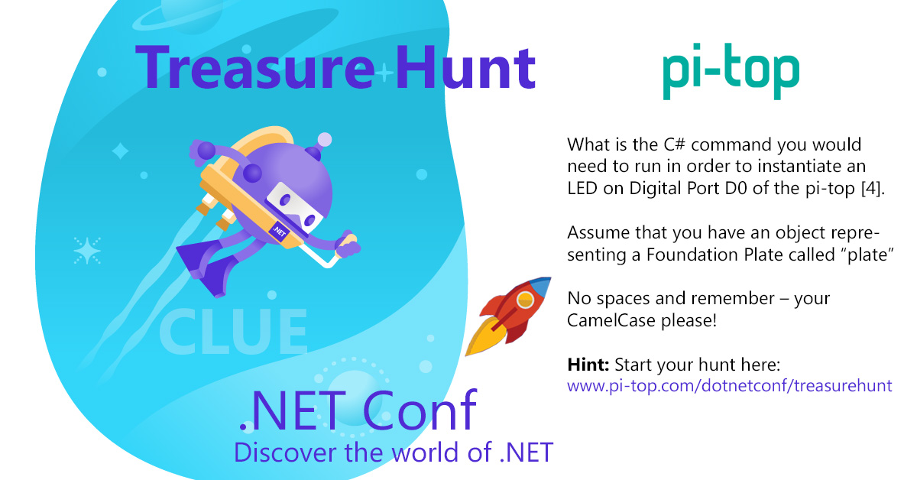
Technical Treasure Hunt (sponsored by .NET Partners)
Do you like solving hard technical problems and winning amazing prizes?
Go to dotnetconf.net/TreasureHunt and follow the clues
There will also be clues given throughout .NET Conf (that means you need to watch the whole event!)
All participants who complete the challenges will be entered to win the grand prizes (including Xbox One, $1500 gift card to MS Store, Star Wars Lego set, and more!)

Slide 18

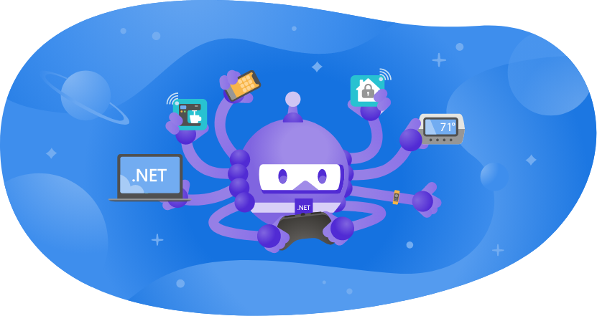
Swag Bags & Digital Swag
Step 1: Go to https://www.dotnetconf.net/swag
Step 2: Check out all the cool, free digital swag!
Step 3: Complete the form to win one of twenty epic swag bags
What do I get? Incredible prizes from our generous sponsors and includes software licenses, t-shirts, hoodies, socks, gift cards and more!

Slide 19

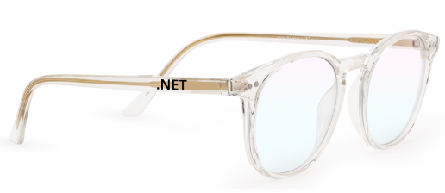
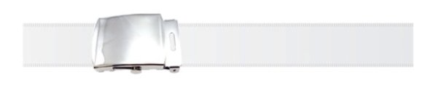
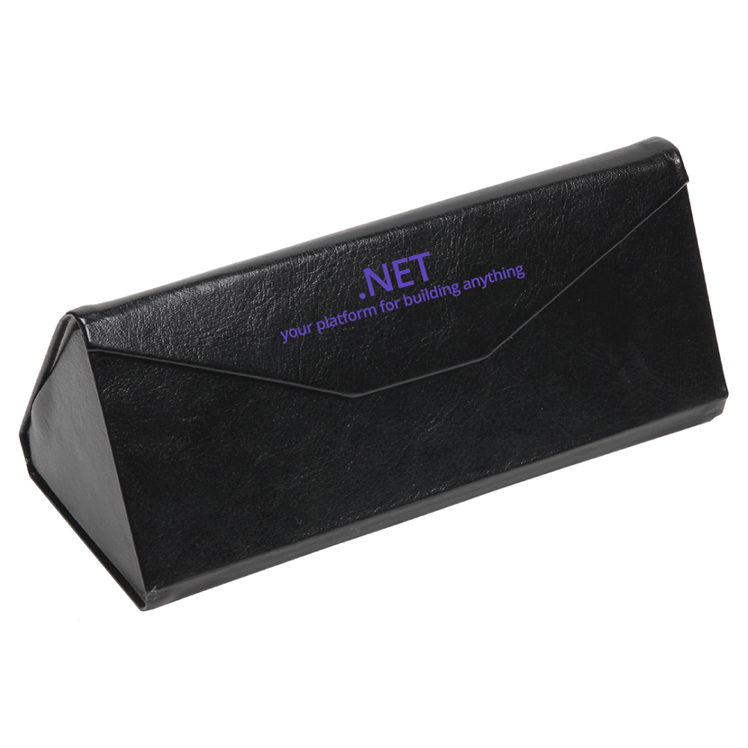
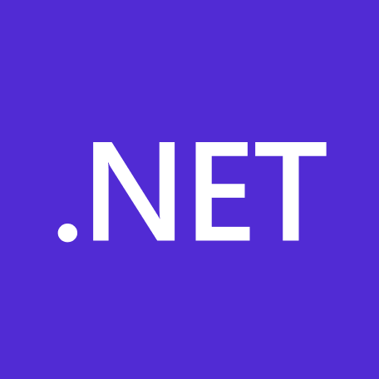
.NET Foundation merch
Check out store.dotnetfoundation.org
Dotnet-bot replica belt
Blue light canceling glasses
Shoelaces
Scrunchies
Mouse pads
Attendees will get a gift card for:
Getting their question asked live on the broadcast
Answering a trivia question correctly at the virtual attendee party

Slide 20
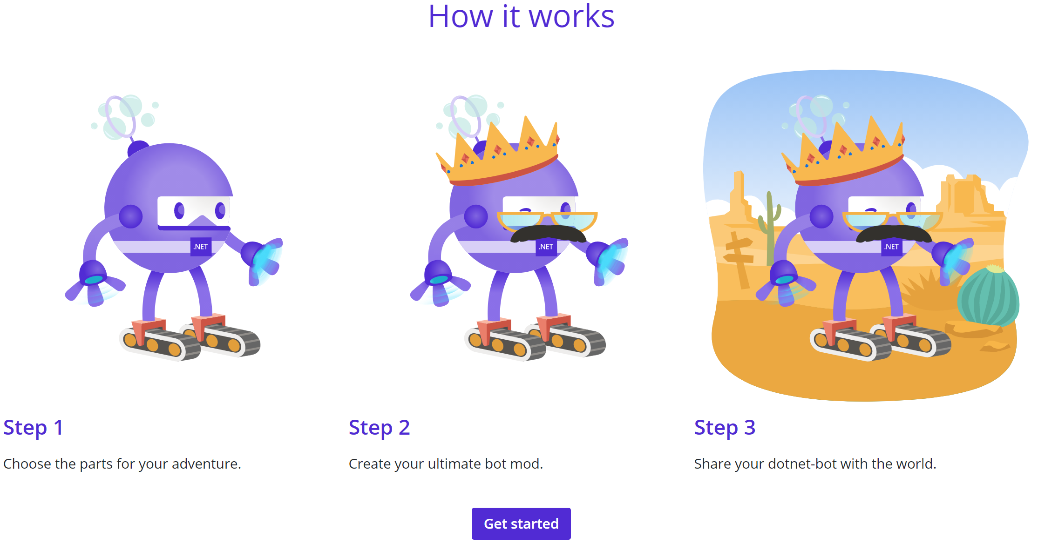
Mod the dotnet-bot
https://mod-dotnet-bot.net/
Create your own coding companion

Slide 21
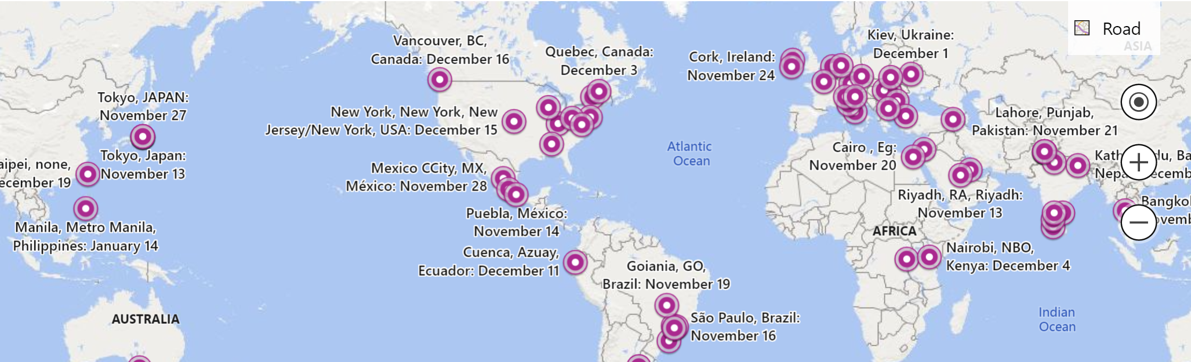
Community-run virtual events
www.dotnetconf.net/local-events
The learning doesn’t stop this week! Attend a community virtual event.
.NET Foundation is supporting community-run virtual events to help spread the word about .NET
Events run between November 13, 2020 and January 31, 2021

Slide 22
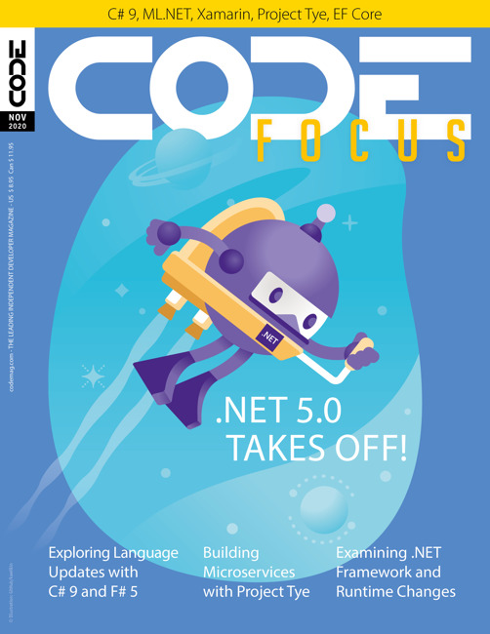
Special Edition CODE Magazine
Everything you need to know about .NET 5 written by .NET team members & experts
Online and available for free: aka.ms/dotnet5-CodeMag

Slide 23

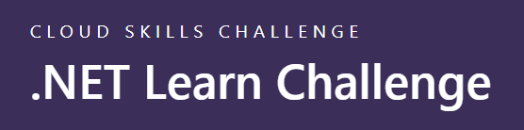
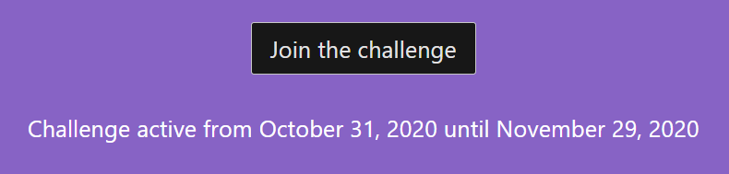
Microsoft Learn for .NET Discover your path
aka.ms/mslearn-dotnet
aka.ms/dotnetskills
Notes:
New learning paths available on Microsoft Learn website for learning all about .NET and getting started with C#. You can also compete against friends and co-workers and take the .NET Learn Challenge!

Slide 24
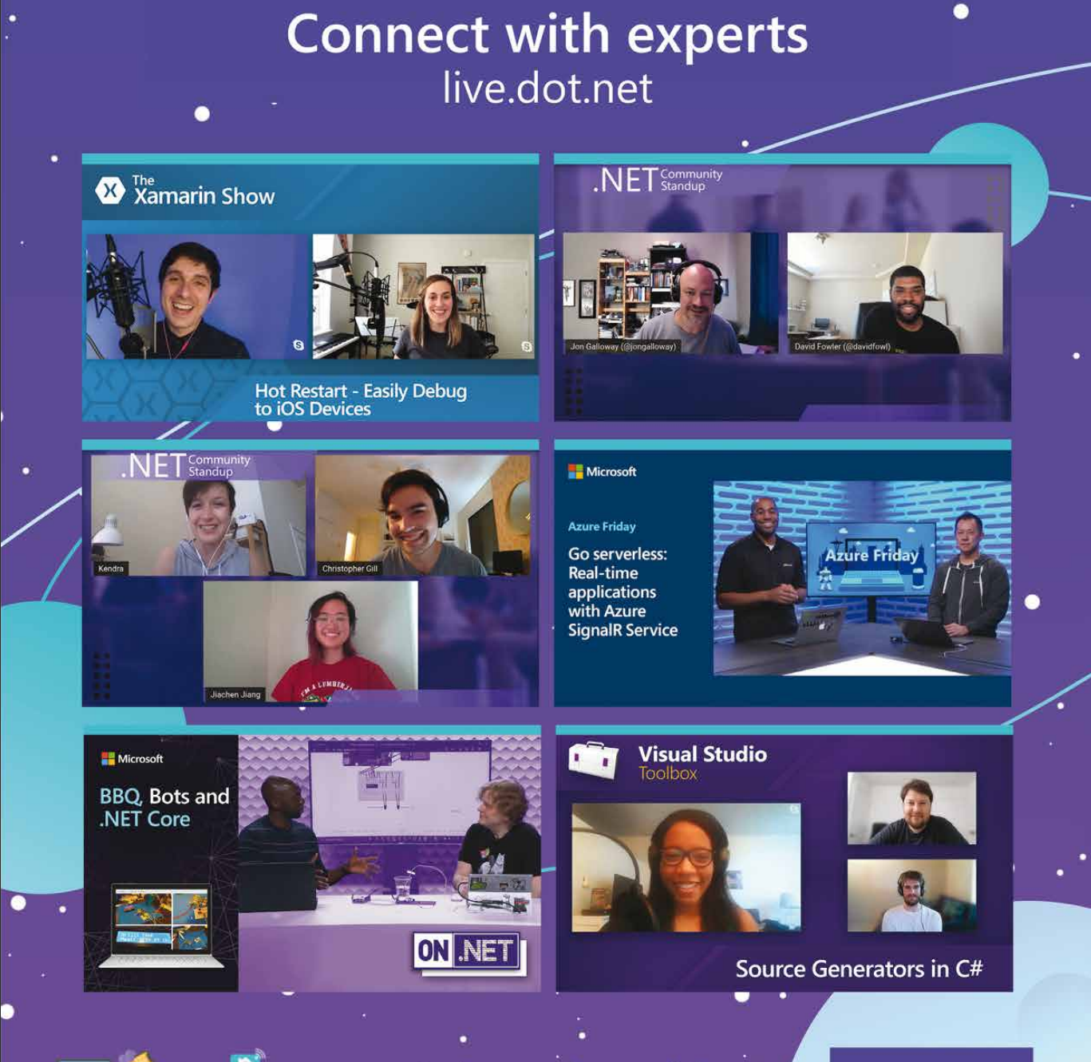
Live TV shows all about .NET live.dot.net

Slide 25
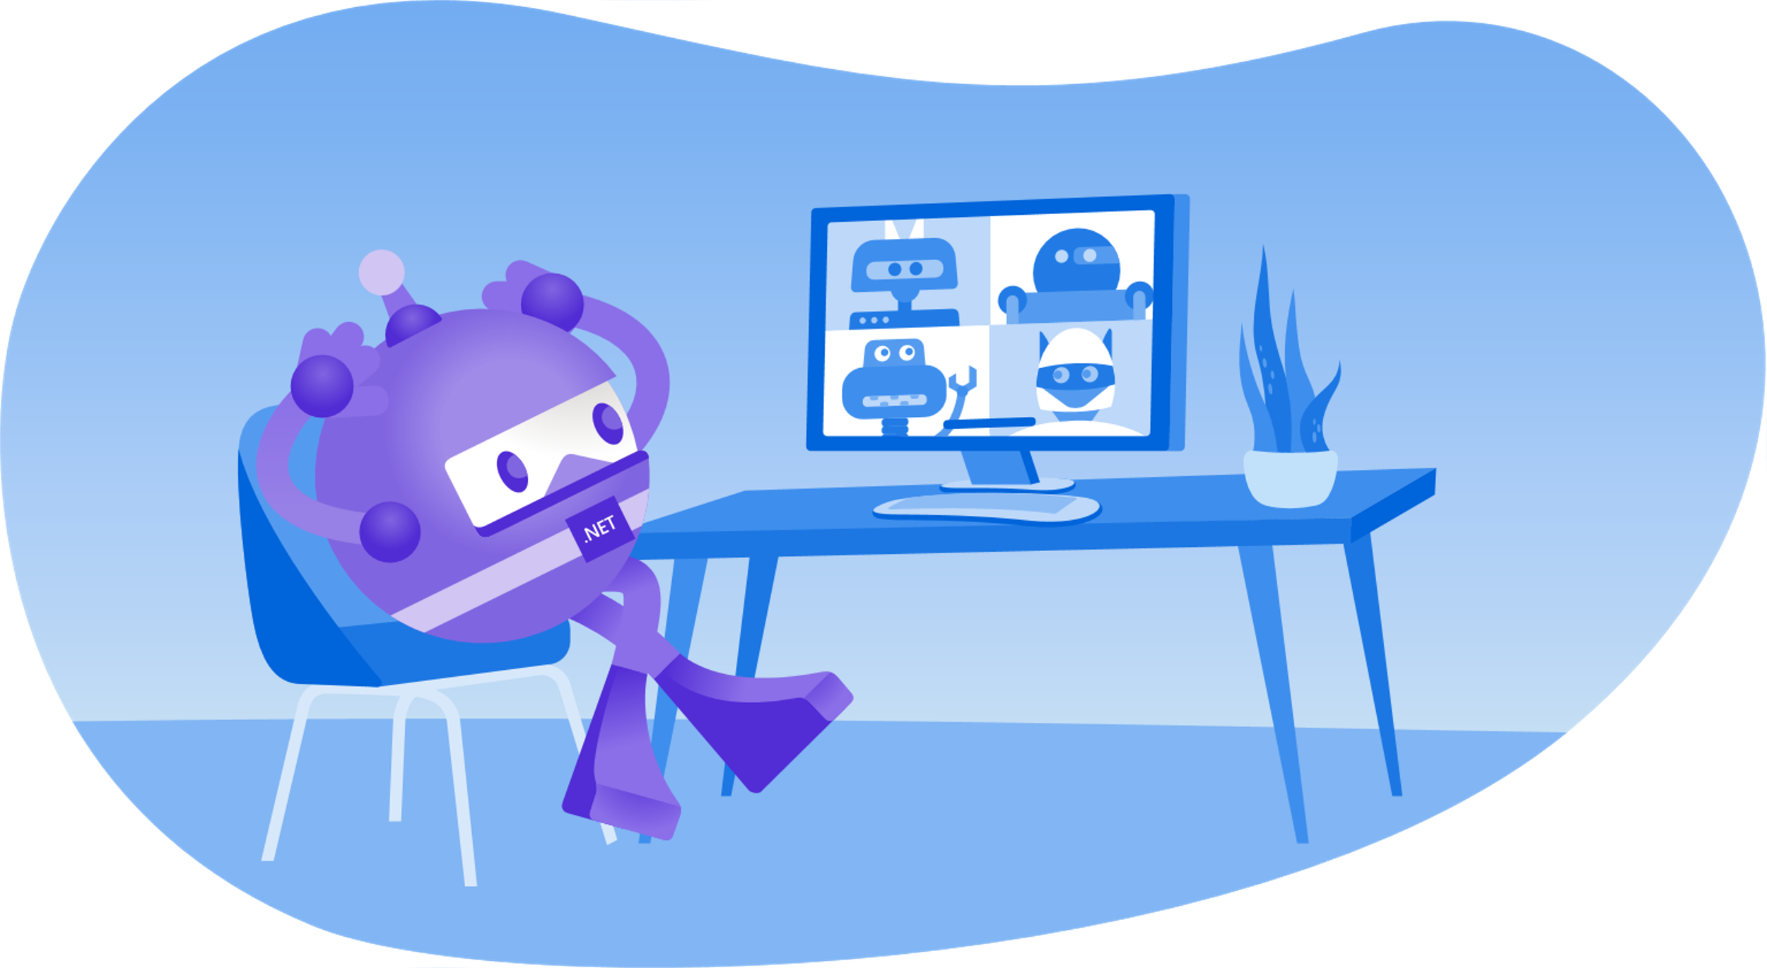
Sit back, relax, enjoy the conference!
Ask questions on Twitter: #dotNETConf

